Slide 1


The New Science of
Soil Organic Matter Formation and its
Practical Implications for Organics
Dr Charles ‘Merf’ Merfield MRSNZ
charles@merfield.com
charles.merfield@bhu.org.nz
Merfield Agronomy Ltd.
www.merfield.com/merfield-agronomy-ltd/
The BHU Future Farming Centre
www.bhu.org.nz/future-farming-centre

Slide 2
Outline
The soil science revolution
What that means for organics
The three legged stool of practical soil management
  Physical
  Chemical
  Biological
Conclusions

Slide 3
Soil science – a little history
Soil science has been divided from its inception
  As a ‘pure’ science studying soil for knowledge
    ‘Real soil scientists’
  As a practical science studying soil for agri/horticultural production
    ‘Fertiliser scientists’ and ‘cultivation scientists’
They have very different world views and objectives
Confusingly they all get called ‘soil scientists’

Slide 4
Soil science – a little history
Until the 1990s it was very difficult to study soil!
  It’s opaque to visible light
  As soon it is disturbed (dug up) many properties change
  It has a myriad properties
  It’s the most complex ecosystem anywhere
  It’s right at the heart of planetary systems
  It’s the most complex thing humans manage
  Etc., etc,

Slide 5
Soil science – a little history
Until the 1990s soil science could only study
  Soil physics – often aimed at cultivation
  Soil chemistry, often NPK and pH
  Soil biology and ecology
    Only big stuff you can see, including with a light microscope
    Microbes that can be cultured (Petri dish) – probably less than some 1% of all microbes – the ‘great plate count anomaly’
Lots of things could not be studied due to a lack of ‘tools’ / technologies

Slide 6
The soil science revolution
Post 2000 a huge range of new tools become available
Biology
  Genetics, ‘omics (measuring biochemistry in bulk), lab tools, (microcosms) mass spectrometers, radioactive / isotope tracers, computing power etc.
Physics – including soil structure
  Better microscopes…

Slide 7
Synchrotron ‘light’ sources
Particle accelerators
Generate insanely ‘bright’ beams of X ray ‘light’
Generate astonishingly detailed 3D ‘pictures’ of objects, e.g., clump of soil

Slide 8
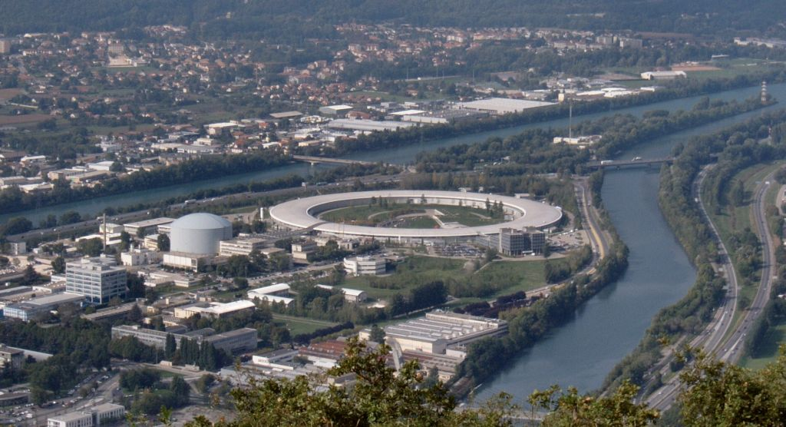
European Synchrotron Radiation Facility

Slide 9
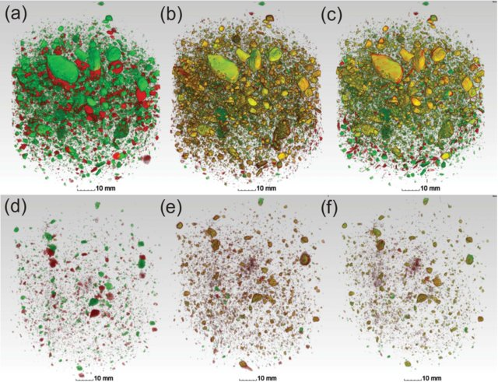
3D microtomography
X-ray microtomography analysis of soil structure deformation caused by centrifugation 2015 Schlüter Leuther Vogler Vogel

Slide 10
Visualisation of soil pore space
This animation shows a visualization of pore space within a 0.5 cm cube of soil. The original data was captured using x-ray tomography. Image analysis techniques have been used to define 'solid material' (the soil) from 'air' (the pores).
The animation starts with a thresholded model of the soil cube. As the soil cube rotates the pore space is coloured in green. The soil cube is then faded away to leave only the connected pore network of the soil. The animation ends with a return to the original starting conditions.
https://www.youtube.com/watch?v=Jurn0euTrxE

Slide 11


Slide 12
Soil biology and ecology
Using genetic technique can now ‘see’ the vast range of soil organisms, especially microbes…

Slide 13
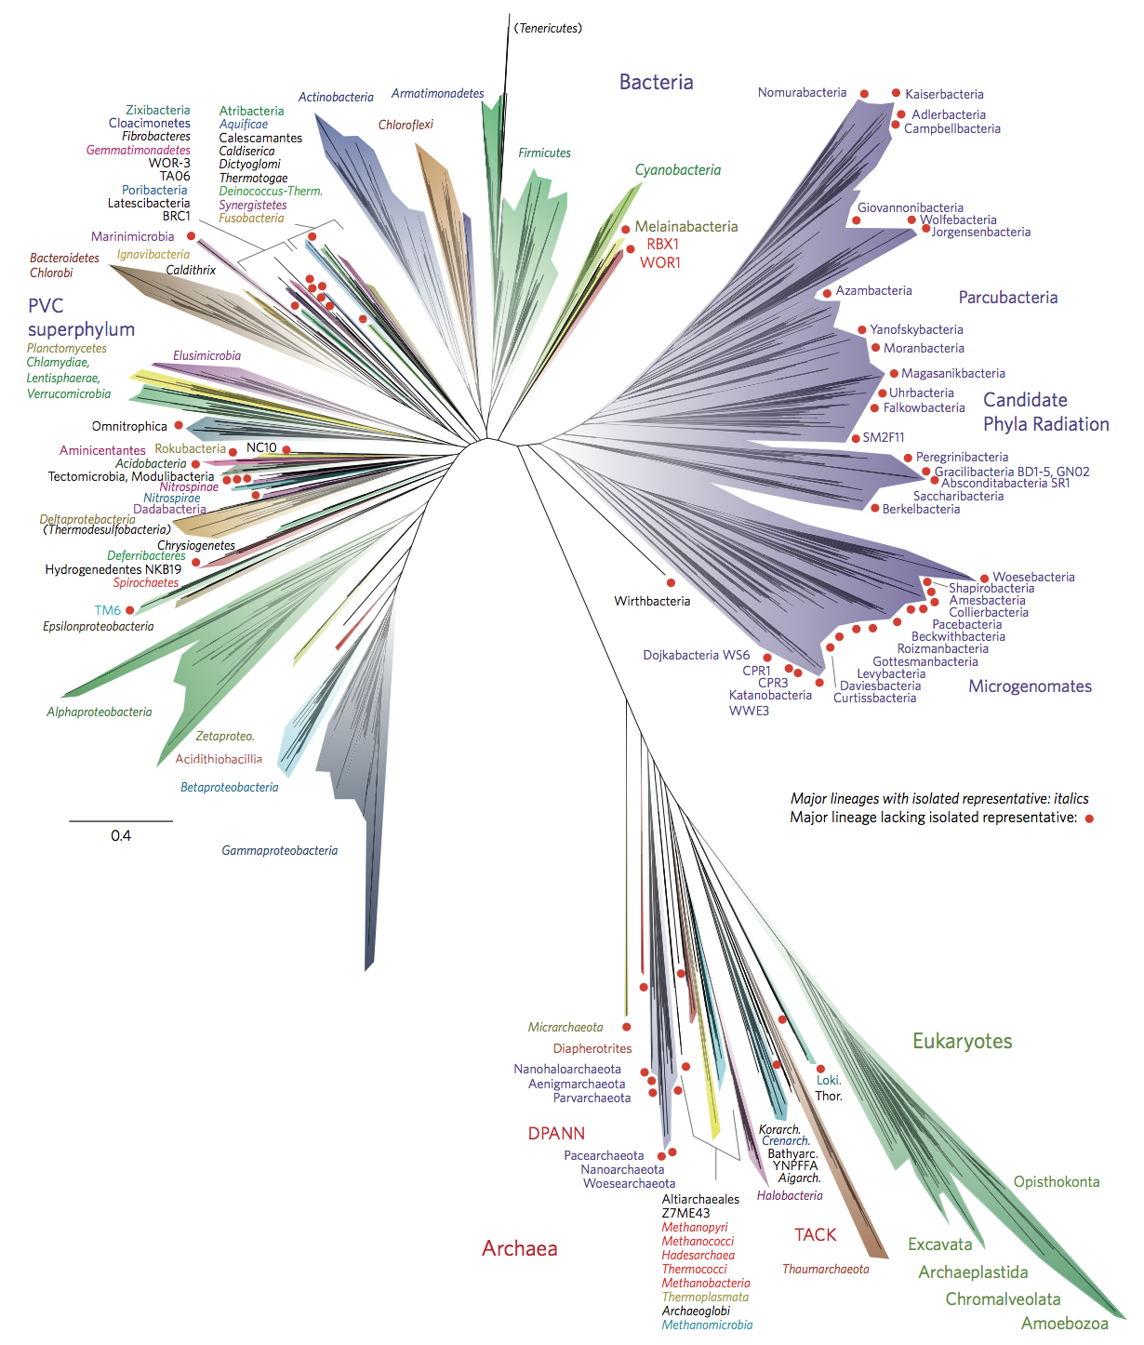
A current view of the tree of life, encompassing the total diversity represented by sequenced genomes
Bacteria
A new view of the tree of life. Nature Microbiology.
www.nature.com/articles/nmicrobiol201648
Archaea
All animals and fungi descend from Opisthokonta
Eukaryotes
Plants are Archaeplastida

Slide 14
Soil biology and ecology
Nearly all life on earth, including in the soil, is prokaryotes – bacteria and archea
  These do ALL the ‘heavy’ biochemical lifting, e.g.,
    Nitrogen fixation by diazotrophs
    Transformation of mineral nitrogen species, ammonia to ammonium, to nitrite, to nitrate
    Production and consumption of methane
Eukaryotes
  Mostly ‘decoration’
  Key exception is plants and lesser extent fungi

Slide 15
Soil biology and ecology
Ecology joke
  If the last blue whale choked to death on the last polar bear it would be sad but of no consequence
  If the last ammonium oxidising bacteria went extinct then the show is over

Slide 16
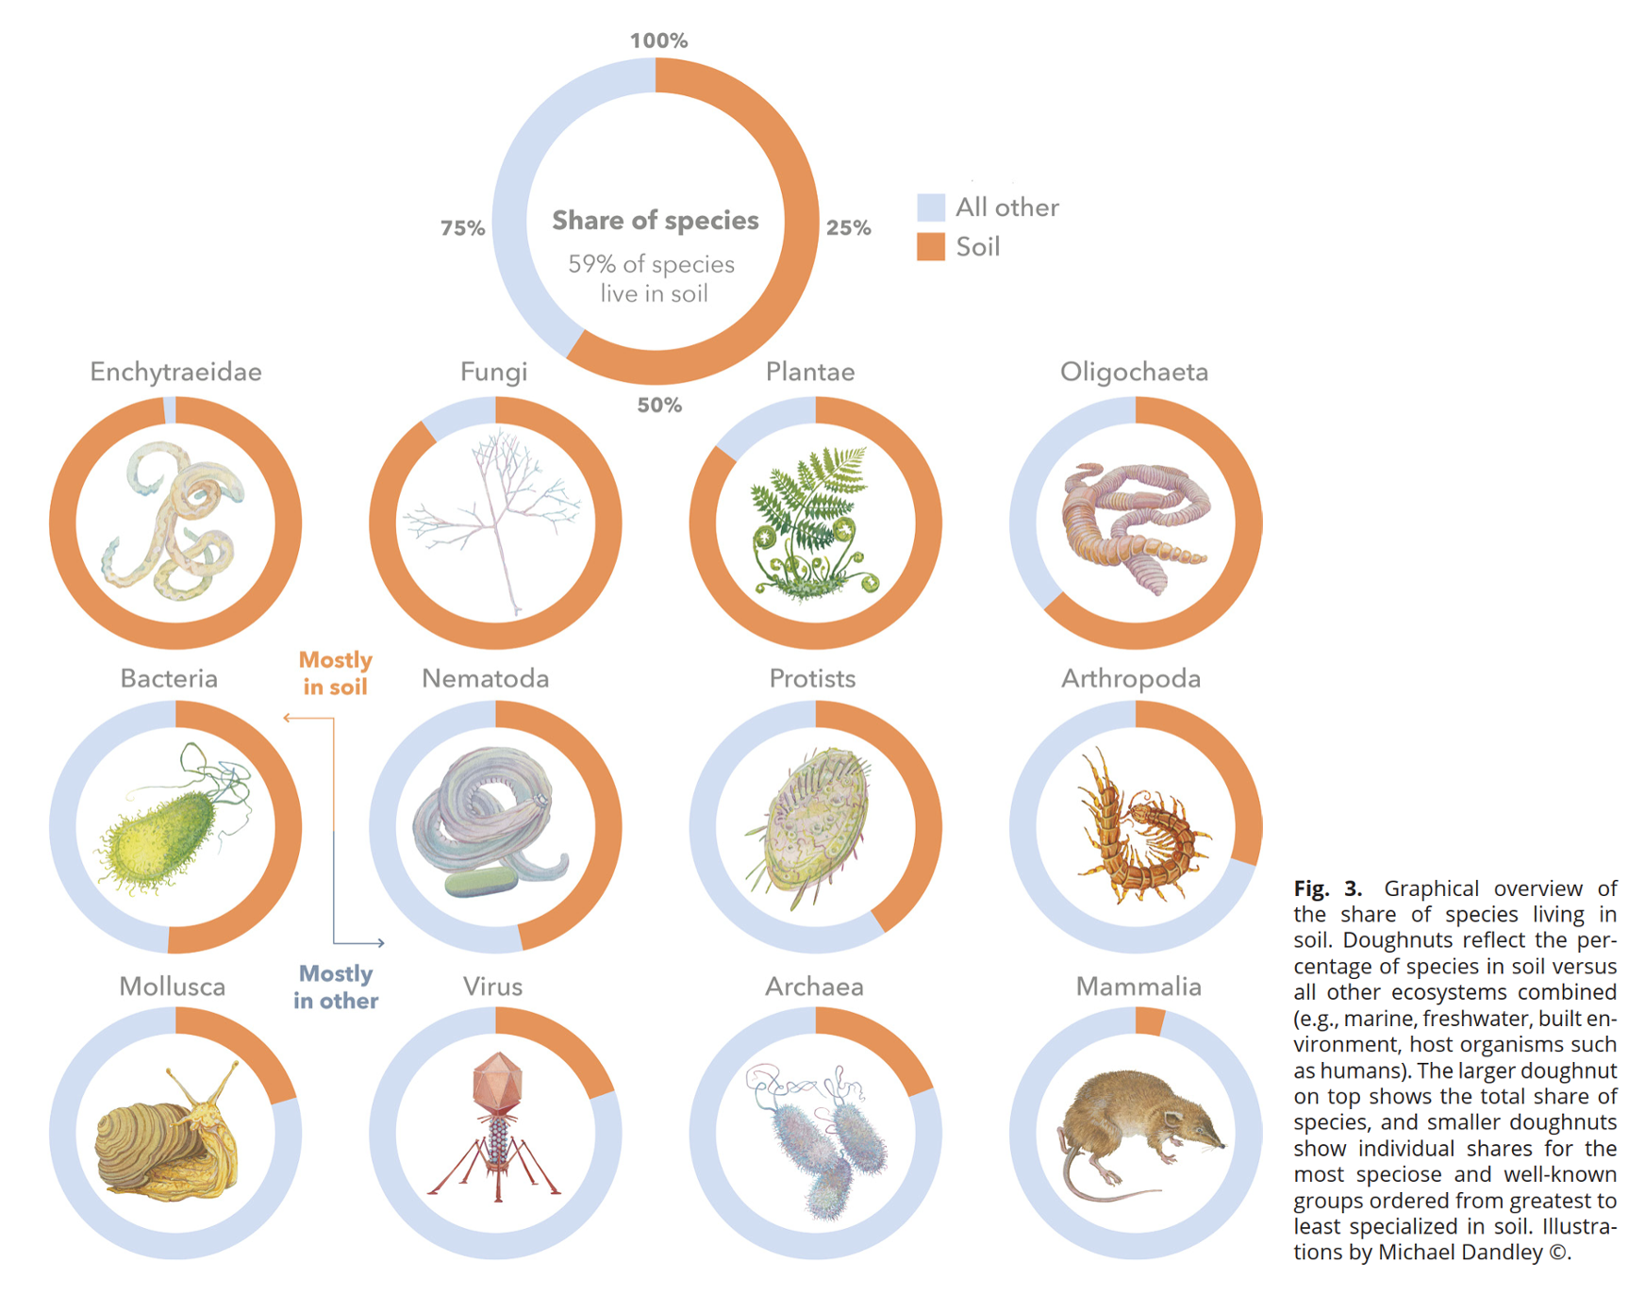
~60% of all species make soil their home
Enumerating soil biodiversity 2023
https://doi.org/10.1073/pnas.2304663120

Slide 17
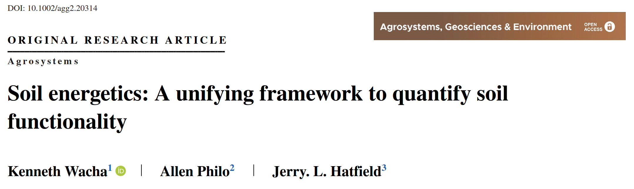
From static to dynamic
Soil is now viewed as a complex dynamic system rather than static system
Energy flow is a key concept

Slide 18
Soil energetics
Massive quantities of energy flow through soils during a year. Emerging views indicate that when supplied with abundant energy, soil biology acts as a self-organizing system as soil microbes forge their habitats into a porous, well-aggregated structure with high functionality.
Wacha, K., Philo, A. & Hatfield, J. L. (2022). Soil energetics: A unifying framework to quantify soil functionality. Agrosystems, Geosciences & Environment, 5(4), e20314. doi:10.1002/agg2.20314

Slide 19
Soil is a living thing
Soil science is increasingly viewing soil as a being alive, not just a structure in which life exists
Soil is also increasingly viewed not as a static entity but as a series of processes – a complex adaptive system
Energetics is increasingly seen as a key window on those processes

Slide 20
The soil organic matter revolution
The revolution has also turned the understanding of the formation of soil organic matter (SOM, aka soil organic carbon) on its head!
And has massive implications for organic farming

Slide 21
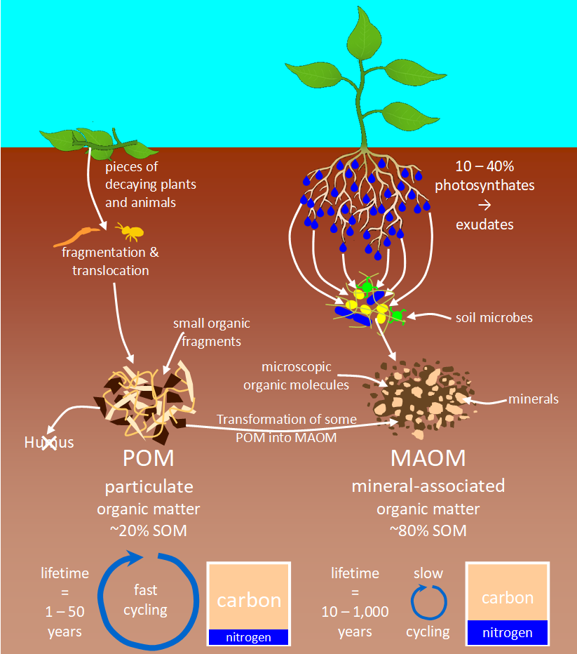
Soil science revolution
Based on: Cotrufo, M. F., Lavallee, J. M. & Sparks, D. L. (2022). Soil organic matter formation, persistence, and functioning: A synthesis of current understanding to inform its conservation and regeneration. In Advances in Agronomy (Vol. 172, pp. 1-66): Academic Press. doi:10.1016/bs.agron.2021.11.002 https://www.sciencedirect.com/science/article/pii/S0065211321001048

Slide 22
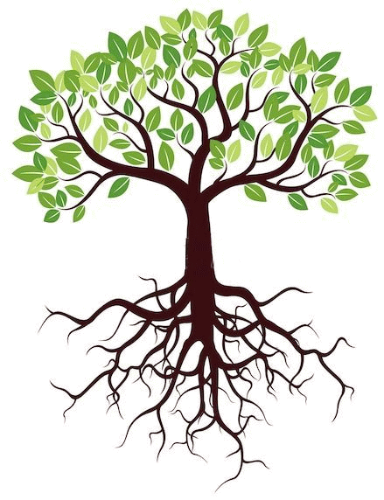
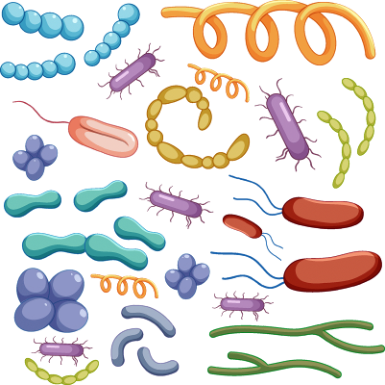
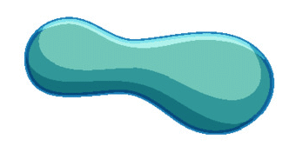
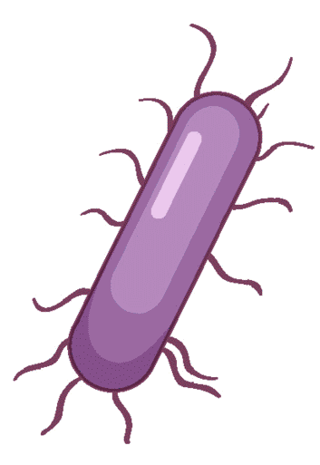
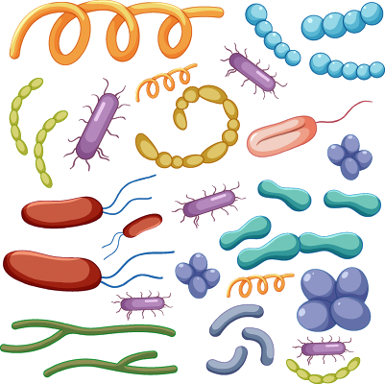

Turning plants upside down
CO₂
C 45%, O 45%, H 6%
Vecteezy.com

Slide 23
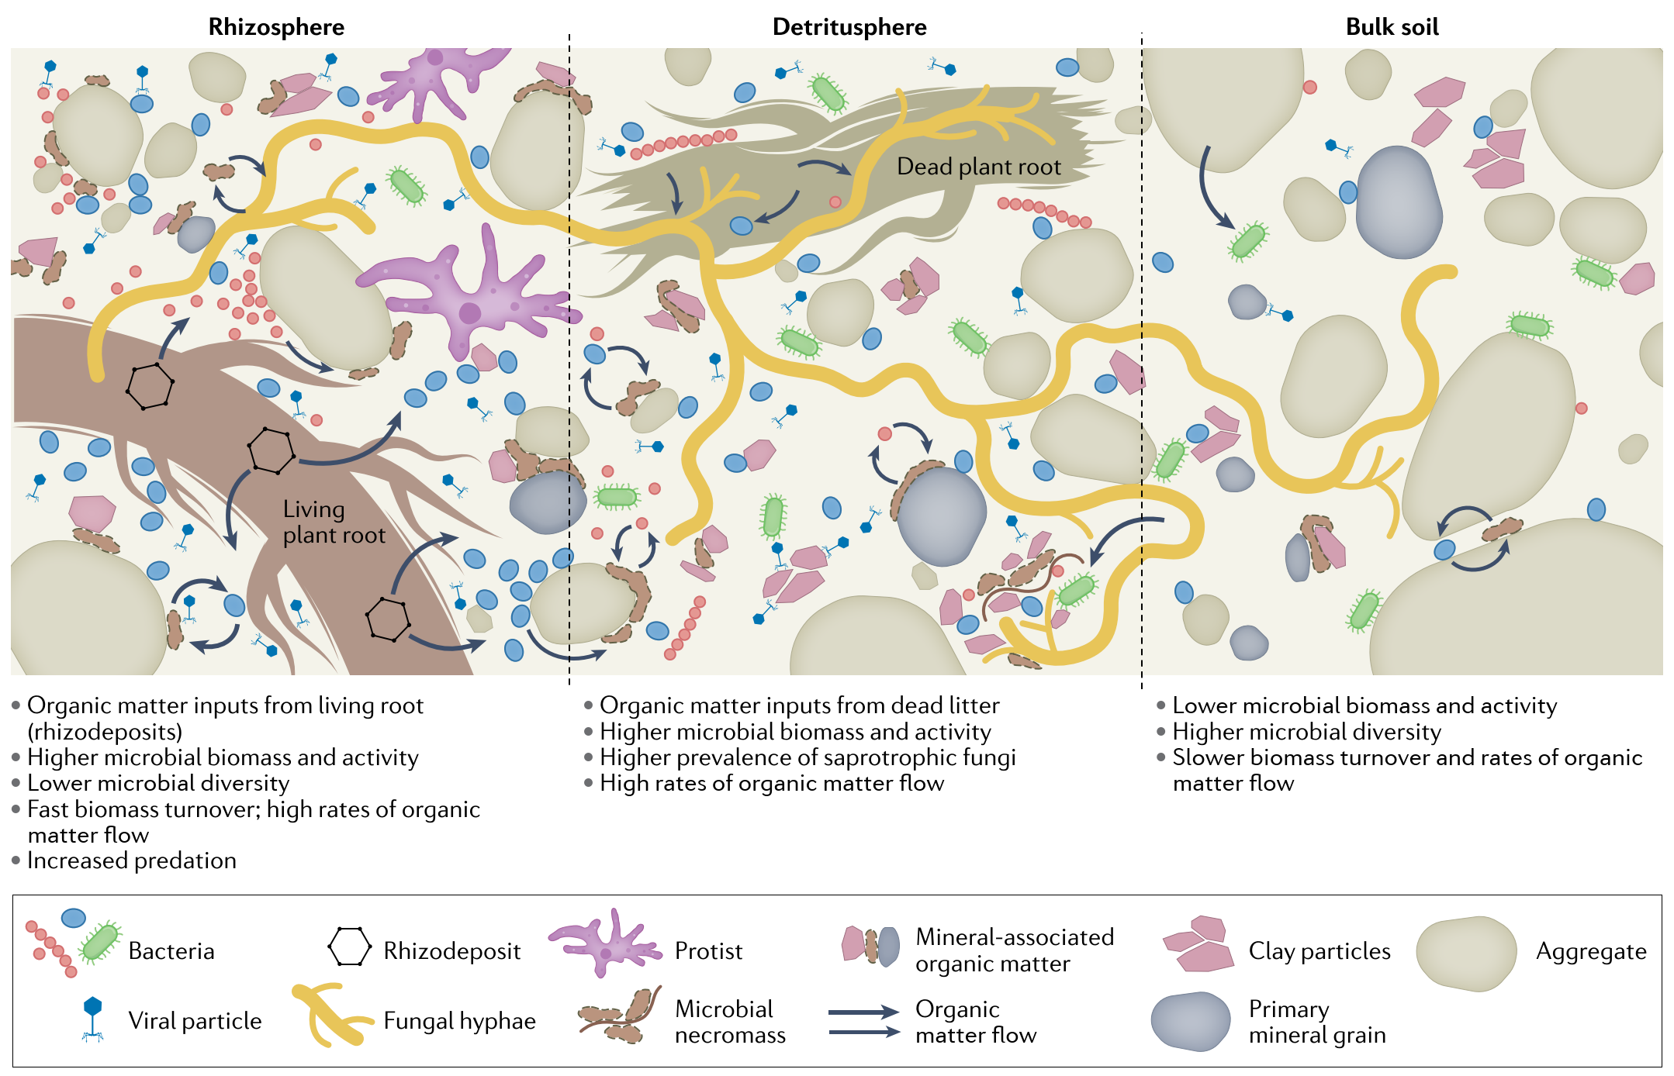
From roots to bulk soil
Life and death in the soil microbiome: how ecological processes influence biogeochemistry 2022 Sokol Slessarev et al

Slide 24
****What this means****
This is the key take-home
It is a diversity of living plants, maximising photosynthesis, to maximise root exudates and energy flow, to maximise rhizosphere microbiology, that maximises MAOM which maximises soil health
Organic inputs, such as plant residues, manure and compost play a vastly more minor role than previously thought

Slide 25
The soil revolution catchphrase
Humus is dead: Long live MAOM!

Slide 26
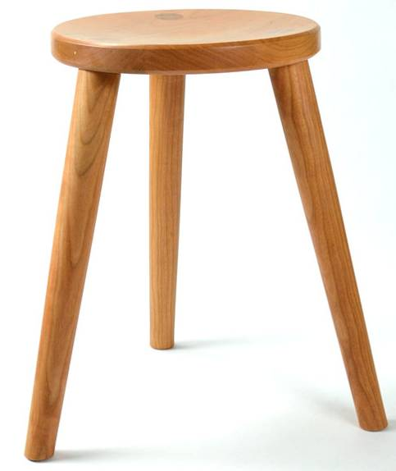
The three legged stool of soil management
1 Physical
  Soil structure, aggregation, lack of compaction
2 Chemical
  Nutrients both major and micro + pH
3 Biological / ecological
  The living things that make soil, soil
All of them are required
  If one is sub-optimal the others
  can NOT compensate

Slide 27
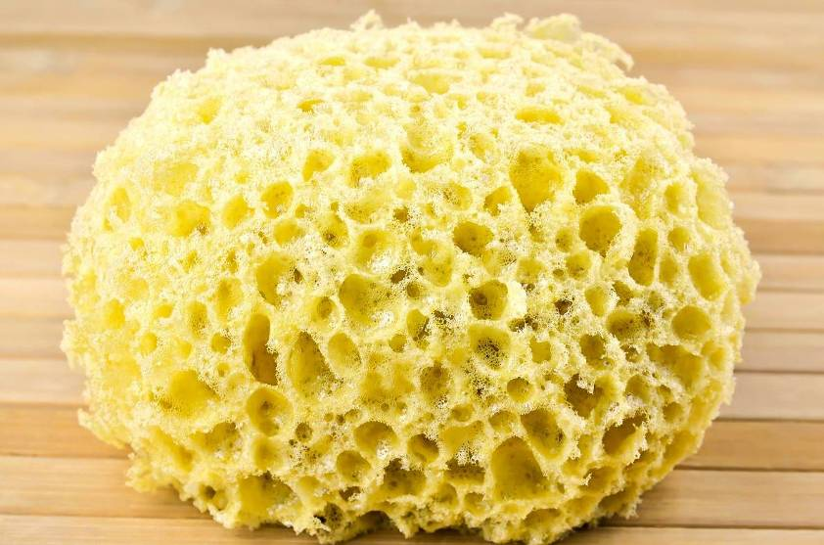
Soil physical health
Soil physical health = good structure – well aggregated and highly porous
Good soil structure is like a sponge – about 25% pores
Good structure allows water and gas exchange

Slide 28
Soil physical health
The three key things that destroy soil structure are:
  Compaction
  Tillage / cultivation
  Lack of a diversity of living plants

Slide 29
Chemical soil health
Chemical soil health = optimum nutrients and pH
  In the ‘Goldilocks zone’ not too little and not too much
Going to look at chemical soil health from the perspective of stoichiometry - the ratio of the chemical elements of life.

Slide 30
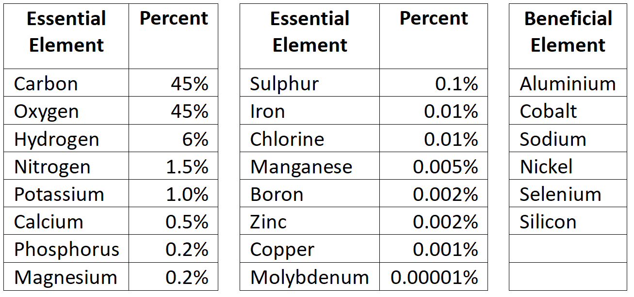
Stoichiometry
The percentage of plant nutrients

Slide 31
Stoichiometry
All living things have similar proportions of the chemical element / nutrients
The right amount of soil nutrients for plants = the right amount of nutrients for all biology
Macronutrient – needed in larger amounts
  C, O, H, N, P, K, Mg, Ca, S
Micronutrients – needed in smaller amounts
  Fe, Cl, Ma, B, etc

Slide 32
Nutrient cycles
C, O and H = 96% plant dry matter
  ‘Atmospheric’ nutrients – cycle via the atmosphere as gasses
P, Ca, K, Mg, etc 3% of plant matter
  ‘Lithospheric’ nutrients – don’t form gasses only cycle via the soil and rocks of the lithosphere
N – the oddball nutrient
If there were no atmospheric nutrients the amount of fertiliser needed would = dry weight of harvest!

Slide 33
pH
Simple!
Soil tests – lab and in-field
Low pH? Add lime
High pH? Get expert advice

Slide 34
Organic nutrient sources
Manure, compost, plant residues etc
Organics has viewed these – especially compost – as the foundation of soil health
That view is now clearly wrong
They can help, but it’s all about root exudates
The organic ‘play book’ must be rewritten

Slide 35
Organic nutrient sources
They MUST only be applied to address nutrient deficiencies
They are ‘just’ fertilisers
The amounts must only bring deficient levels up to optimum
From a few hundred kg to a few tonnes per ha per year

Slide 36
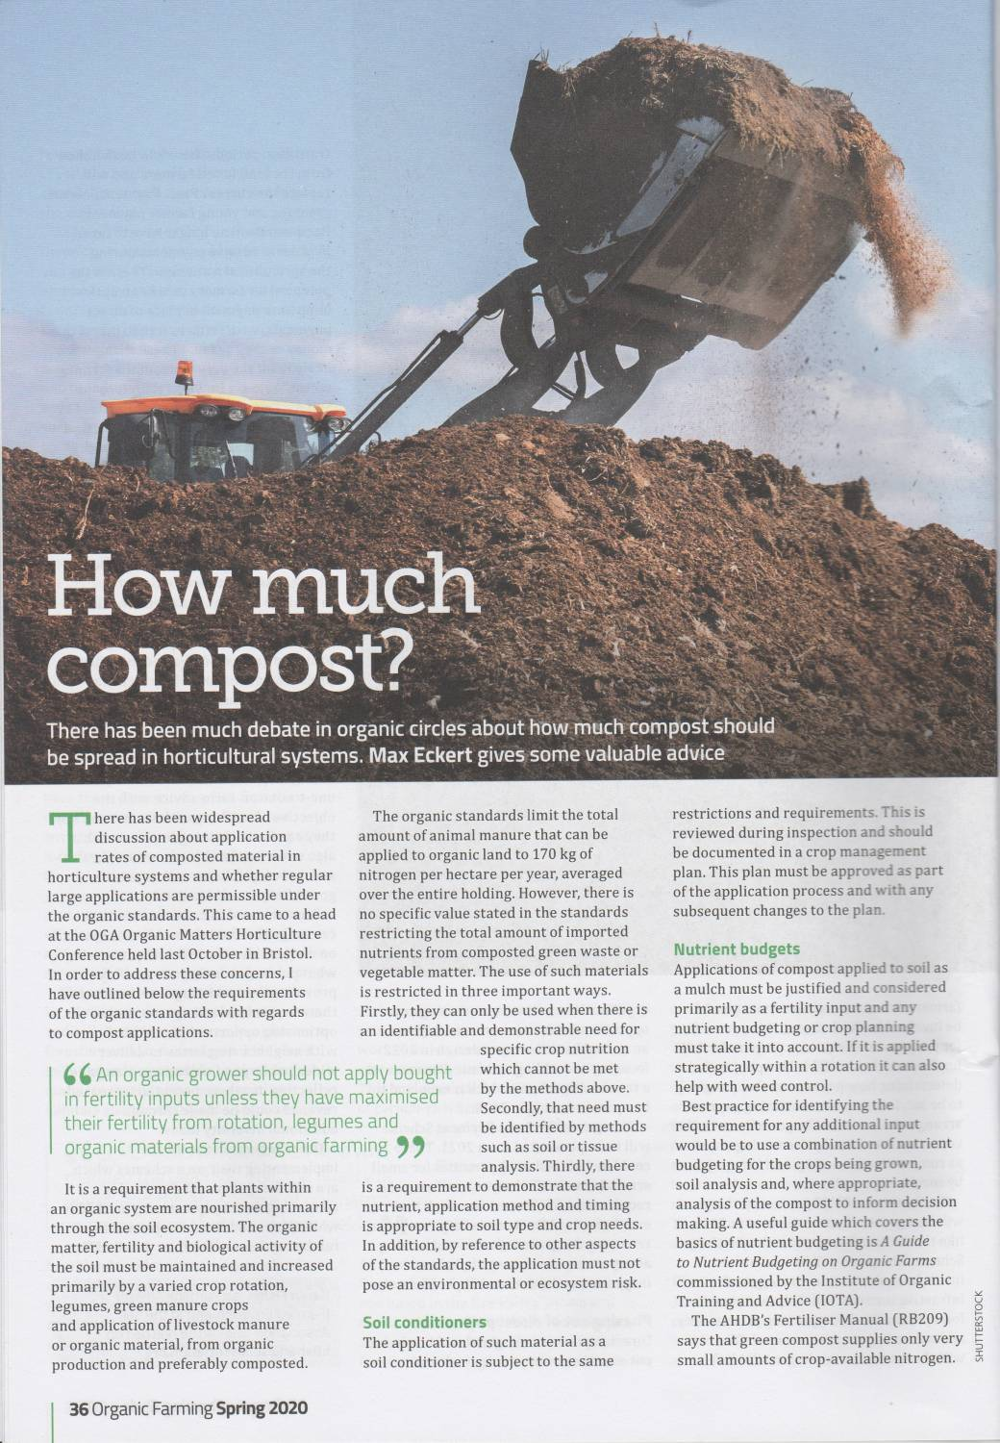
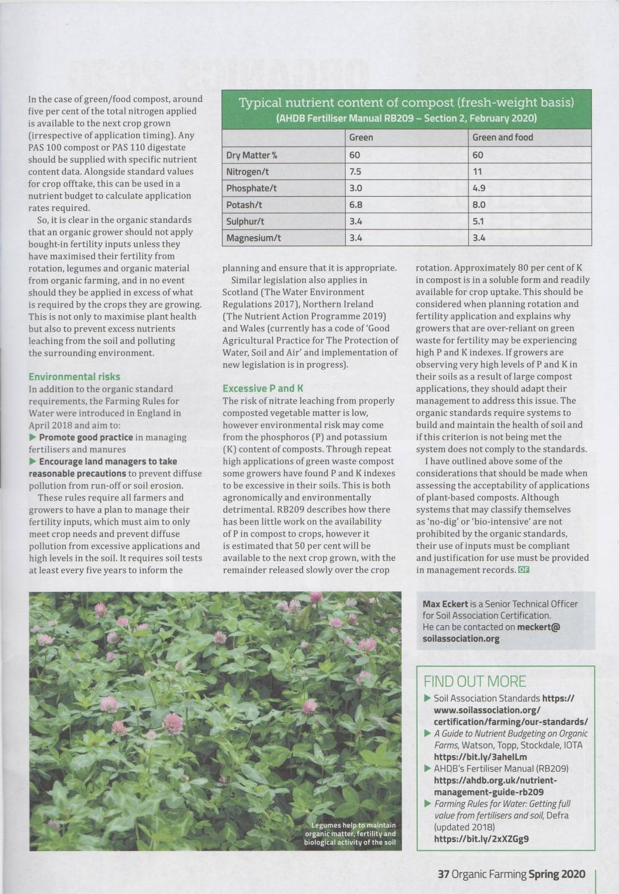
Max Eckert (2020) How much compost? Organic Farming

Slide 37
Biological / ecological soil health
Biology is what makes a soil a soil
The dominant driver of soil biology (ecosystem) is plant root exudates
  Maximising the biomass of plants
  Maximising photosynthesis – energy capture
  Maximising plant diversity
Maximising the diversity of living roots year round
That’s it!

Slide 38

Soil biological health
This soil is dying from a lack of plants despite mulch
https://lumberjax.com/mulching-flower-beds-benefits/

Slide 39
Soil biology
It is plants, bacteria and archaea, with support from fungi that are the important players
Soil biology and ecology are now principally genetic and process based, e.g., energetics
  Optical microscopes are so 20th century!

Slide 40
Managing soil biology
The soil science revolution
Maximising the diversity of living roots year round
  On the basis of good physical and chemical health
That’s it!

Slide 41
Living plants join the sky and soil into a single continuum
Living plants provide all the energy, and much of the complex chemistry that drives soil biology & health

Slide 42
Conclusions
The revolution in soil science must flow through to organic farming and growing
It is exudates from living plant roots not dead organic materials that drive soil biology and health
Despite soil being the most complex and biodiverse ecosystem the fundamentals of good management are very straightforward

Slide 43
Conclusions
Minimise compaction and soil structural damage from livestock, machinery and tillage.
Ensure all nutrients, essential and beneficial, along with pH are at optimum.
Maximise the diversity of plant species in space and time, along with maximising photosynthesis to maximise root exudate production
To maximise soil health

Slide 44
Thank you!
Questions

